Slide 1
British Airways Review Analysis
The Collected data shows many factors which are in play when a passenger is reviewing the airlines experience, like comfort, service, etc.
An effort has been done to analyse these reviews and get a quick look on which factors effect the passenger experience and in what way.
Data has been scraped from Skytrax’s British Airlines Review page.
Link to page: https://www.airlinequality.com/airline-reviews/british-airways/

Slide 2
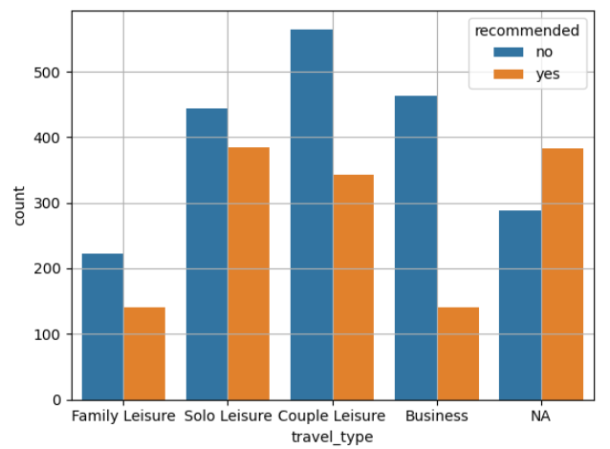
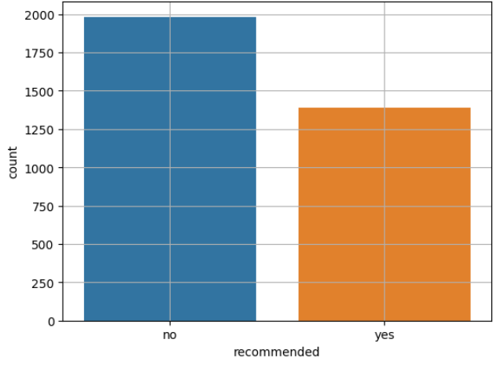
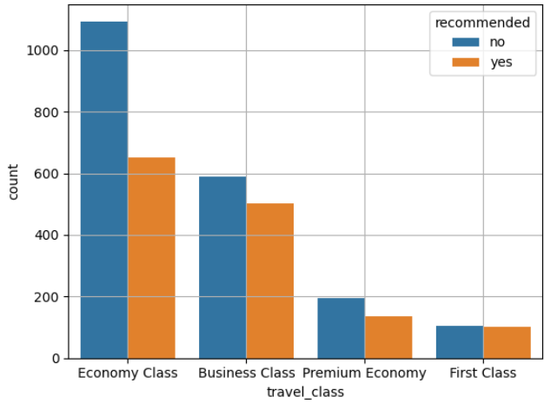
The base for positive and negative is considered to be the recommendation. If the passenger has recommended the flight then its counted as positive and if not then its counted as negative. Below is a graph showing positive and negative sentiments counts for 3375 reviews. On the right side, different graphs show how different factors affect passenger sentiments.

Slide 3
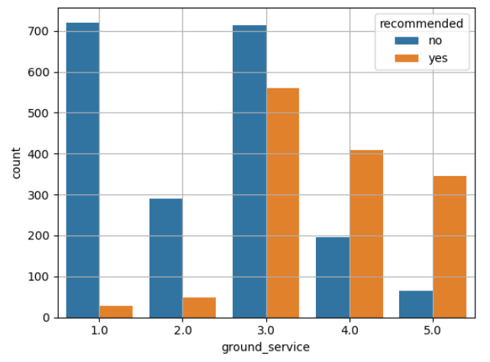
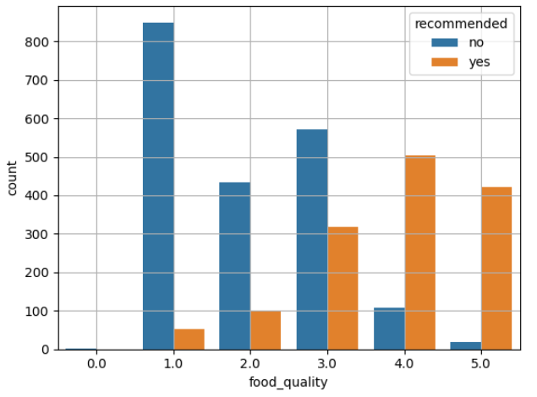
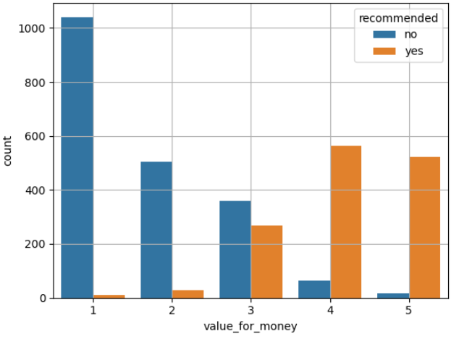
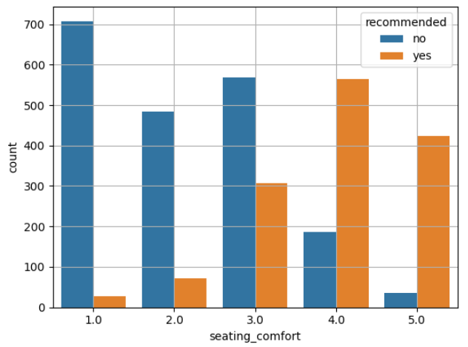
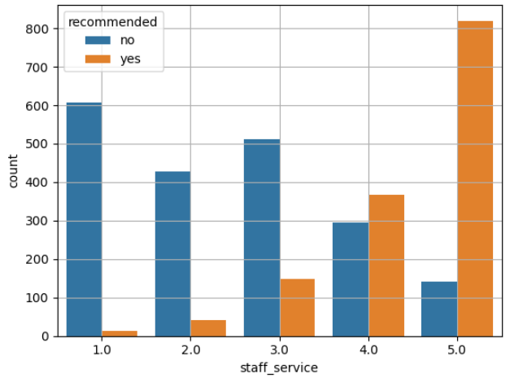

Slide 4
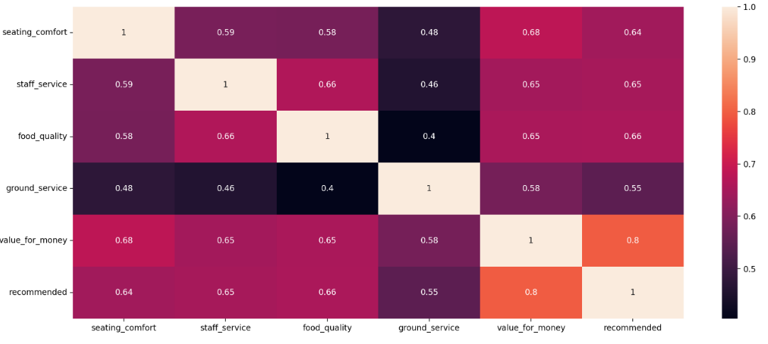
Below is the correlation matrix for all the considered factor and the recommendation. The values in the table are between 0(least related) to 1(most related).
It is clear from this matrix that value for money is the most considered factor by any passenger for recommending or not recommending British airways.
We can also see from this matrix, the magnitude of effect these factors have on value for money.

